Slide 1
A SIMPLE BUT TOUGH-TO-BEAT BASELINE FOR SENTENCE EMBEDDINGS
Sanjeev Arora, Yingyu Liang, Tengyu Ma

Slide 2
INTRODUCTION
Motivation
Recent work has tried to compute embeddings that capture the semantics of word sequences (phrases, sentences, and paragraphs)
Wieting et al., 2016, but supervision seems crucial
Arora et al., 2016, Random Walk on Discourses model for generating text
Contribution
Provided a simple approach to sentence embedding, based on the discourse vectors in the random walk model for generating text (Arora et al., 2016).
Should be used as the baseline to beat in future.
Gives a theoretical explanation of the success of the above unsupervised method
Notes:
Recently, (Wieting et al., 2016) learned general-purpose, paraphrastic sentence embeddings by starting with standard word embeddings and modifying them based on supervision from the Paraphrase pairs dataset (PPDB), and constructing sentence embeddings by training a simple word averaging model.

Slide 3
RELATED WORK
Word embeddings
Obtained from internal representations from neural network models of text
Or by low rank approximation of co-occurrence statistics
Most direct related work: Arora et al., 2016, which proposed a random walk model for generating words in the documents
Phrase/Sentence/Paragraph embeddings
Composing word embeddings using operations on vectors and matrices
RNNs defined on the parse tree
Directed inspiration: Wieting et al., 2016
Learned paraphrastic sentence embeddings by using simple word averaging
Updating standard word embeddings based on supervision from paraphrase pairs
Notes:
Wieting et al., 2016), the supervision being used for both initialization and training.

Slide 4
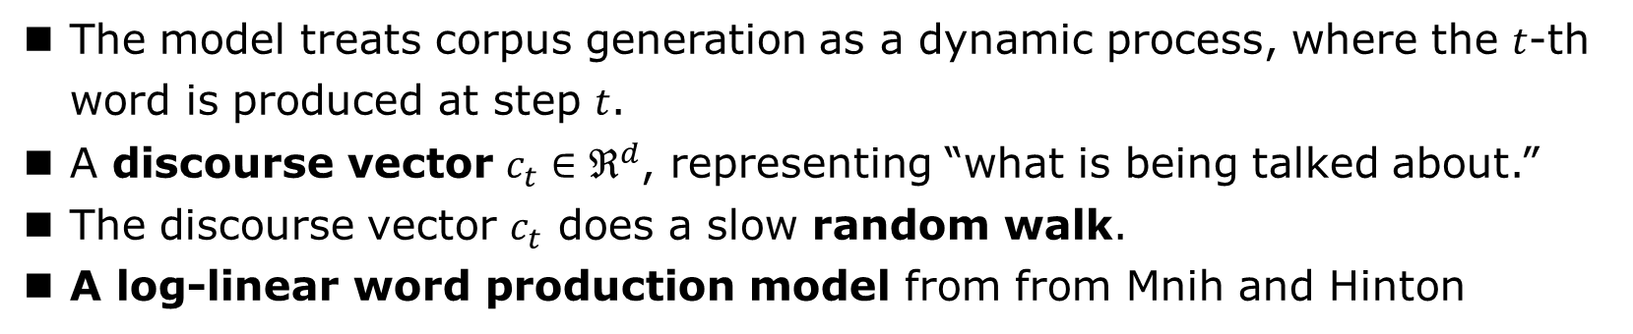
A SIMPLE METHOD FOR SENTENCE EMBEDDING
The latent variable generative model for text in (Arora et al., 2016)
The model treats corpus generation as a dynamic process, where the $t$-th word is produced at step $t$.
A discourse vector $c_{t}∈ℜ^{d}$, representing “what is being talked about.”
The discourse vector $c_{t}$ does a slow random walk.
A log-linear word production model from from Mnih and Hinton
Notes:
The process is driven by the random walk of a discourse vector ct.
The discourse vector ct does a slow random walk (meaning that ct+1 is obtained from ct by adding a small random displacement vector)

Slide 5
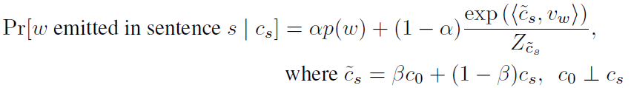

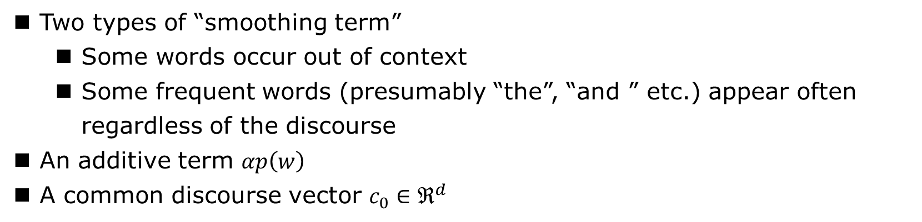
A SIMPLE METHOD FOR SENTENCE EMBEDDING
Our improved Random Walk model
Two types of “smoothing term”
Some words occur out of context
Some frequent words (presumably “the”, “and ” etc.) appear often regardless of the discourse
An additive term $αp\left(w\right)$
A common discourse vector $c_{0}∈ℜ^{d}$
Notes:
we introduce a common discourse vector $c_{0}∈ℜ^{d}$ which serves as a correction term for the most frequent discourse that is often related to syntax.
We see that the model allows a word w unrelated to the discourse cs to be emitted for two reasons: a) by chance from the term p(w); b) if w is correlated with the common discourse vector c0.

Slide 6
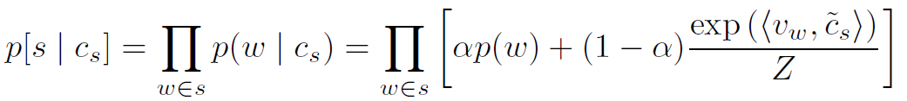
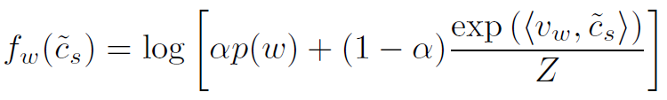
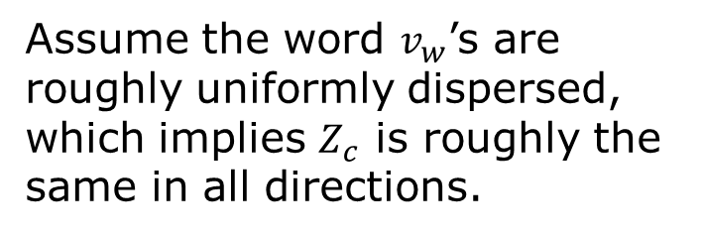
A SIMPLE METHOD FOR SENTENCE EMBEDDING
Assume the word $v_{w}$’s are roughly uniformly dispersed, which implies $Z_{c}$ is roughly the same in all directions.
Computing the sentence embedding
The likelihood for the sentence
Let the log likelihood of sentence $s$
Then
Notes:
The sentence embedding will be defined as the max likelihood estimate for the vector cs that generated it. ( In this case MLE is the same as MAP since the prior is uniform.)

Slide 7
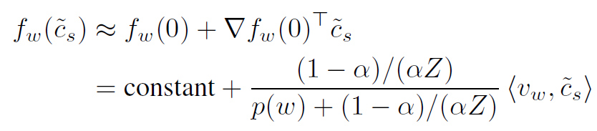

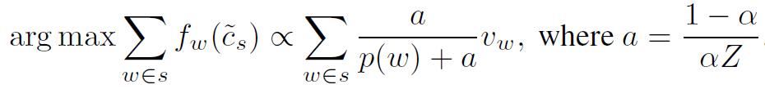
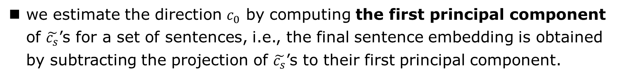
A SIMPLE METHOD FOR SENTENCE EMBEDDING
Computing the sentence embedding
By Taylor expansion
Note that for any constant 𝐶. So the maximum likelihood estimator for $\tilde{c_{s}}$ on the unit sphere
we estimate the direction $c_{0}$ by computing the first principal component of $\tilde{c_{s}}$’s for a set of sentences, i.e., the final sentence embedding is obtained by subtracting the projection of $\tilde{c_{s}}$’s to their first principal component.
Notes:
To estimate cs, we estimate the direction c0 by computing the first principal component of ~cs’s for
a set of sentences.3 In other words, the final sentence embedding is obtained by subtracting the
projection of ~cs’s to their first principal component.

Slide 8
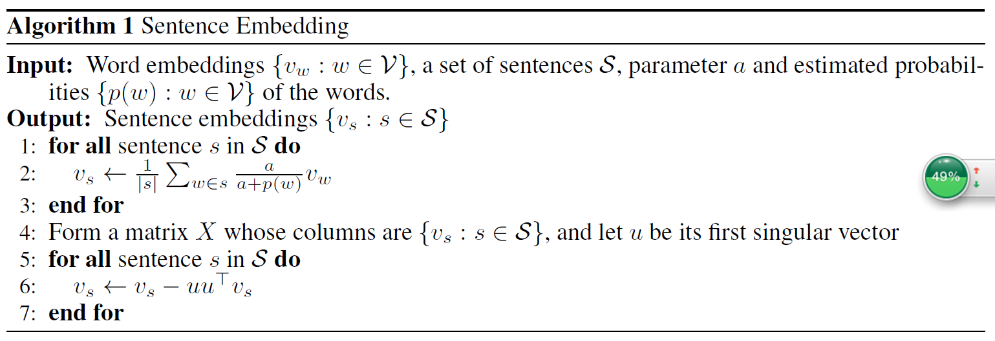
A SIMPLE METHOD FOR SENTENCE EMBEDDING
Computing the sentence embedding

Slide 9
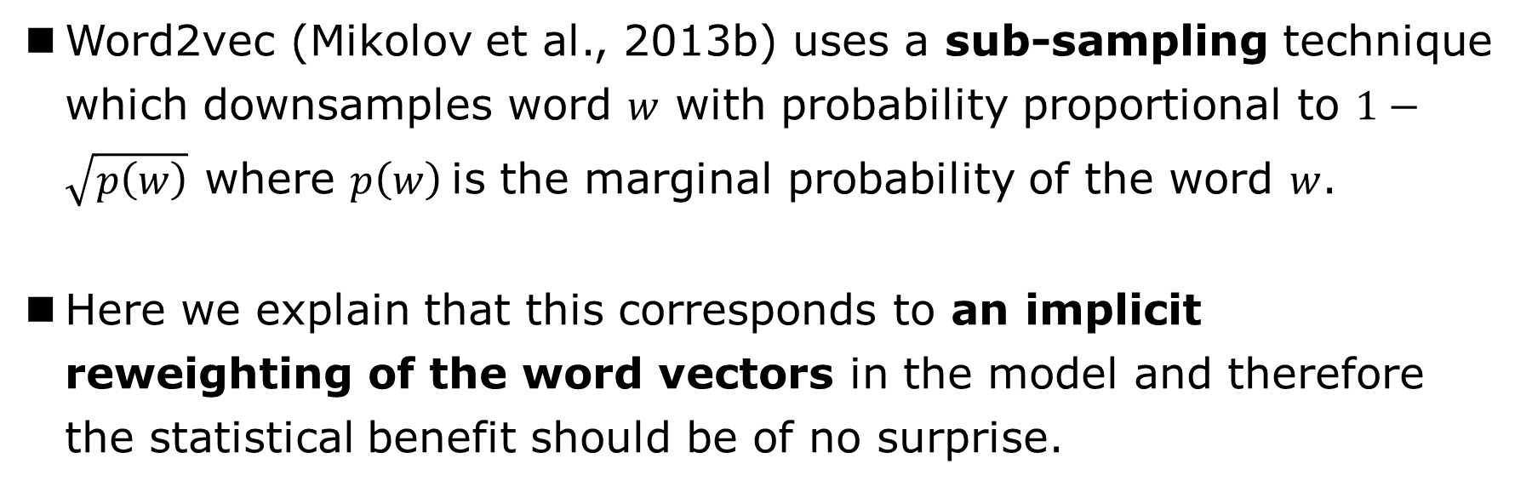
A SIMPLE METHOD FOR SENTENCE EMBEDDING
CONNECTION TO SUBSAMPLING PROBABILITIES IN WORD2VEC
Word2vec (Mikolov et al., 2013b) uses a sub-sampling technique which downsamples word $w$ with probability proportional to $1−\sqrt{p\left(w\right)}$ where $p\left(w\right)$is the marginal probability of the word $w$.
Here we explain that this corresponds to an implicit reweighting of the word vectors in the model and therefore the statistical benefit should be of no surprise.

Slide 10
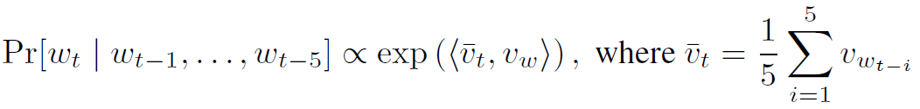
A SIMPLE METHOD FOR SENTENCE EMBEDDING
CONNECTION TO SUBSAMPLING PROBABILITIES IN WORD2VEC
The vanilla CBOW model of word2vec
The loss (MLE) for the single word vector $v_{w}$
Therefore,

Slide 11

A SIMPLE METHOD FOR SENTENCE EMBEDDING
CONNECTION TO SUBSAMPLING PROBABILITIES IN WORD2VEC
With the sub-sampling trick, the sampled update direction is
where Jk’s are Bernoulli random variables with
the expectation of $\tilde{∇}g\left(v_{w}\right)$ is a weighted sum of the word vectors
Notes:
Therefore, the expected gradient here is approximately the estimated discourse vector in our model!
Thus, word2vec with sub-sampling gradient heuristic corresponds to a stochastic gradient update method for using our weighting scheme.

Slide 12
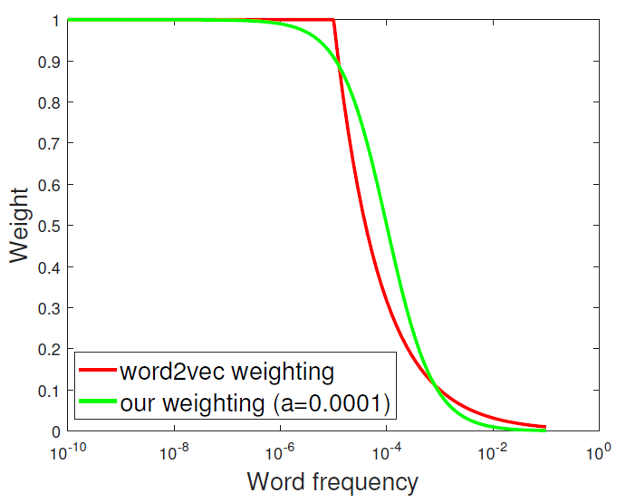
A SIMPLE METHOD FOR SENTENCE EMBEDDING
CONNECTION TO SUBSAMPLING PROBABILITIES IN WORD2VEC

Slide 13
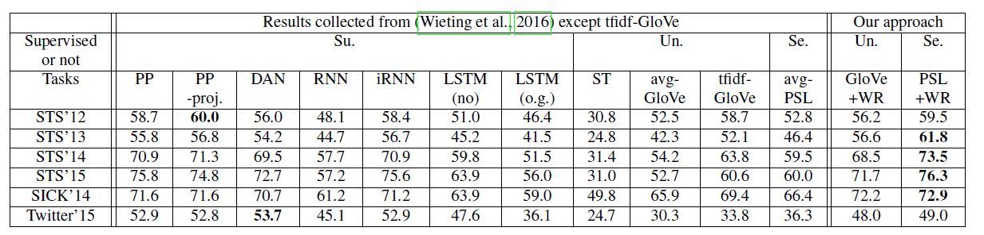
EXPERIMENTS
TEXTUAL SIMILARITY TASKS
“W”: the smooth inverse frequency weighting scheme
“R” : removing the common components.
Notes:
数据集：
The objective of these tasks is to predict the similarity between two given sentences. The evaluation criterion is the Pearson’s coefficient between the predicted scores and the ground-truth scores.
这里是每年平均结果，SCL任务一年4-6次
方法：略
结果分析：
-GloVe+WR: it can be even stronger than highly-tuned supervisedly trained sophisticated models. PSL+WR: 类似，好
-the top singular vectors c0 of the datasets seem to roughly correspond to the syntactic information or common words
-附录部分：说明W和R单独，for GloVe vectors, using smooth inverse frequency weighting alone improves over unweighted average by about 5%, using common component removal alone improves by 10%, and using both improves by 13%.
附录部分更多实验设置细节，这里不再细讲

Slide 14
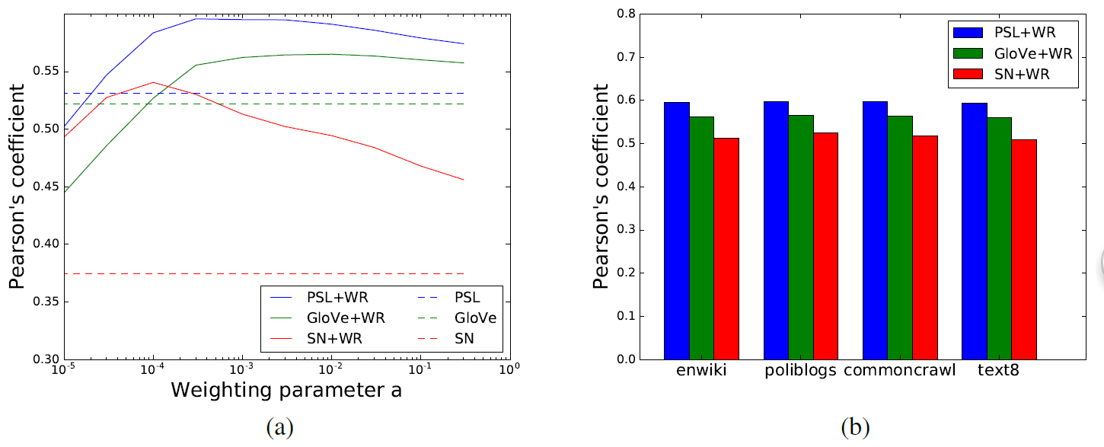
EXPERIMENTS
EFFECT OF WEIGHTING PARAMETER ON PERFORMANCE
Notes:
右图，在不同数据集上估计p(w)，效果差不多

Slide 15
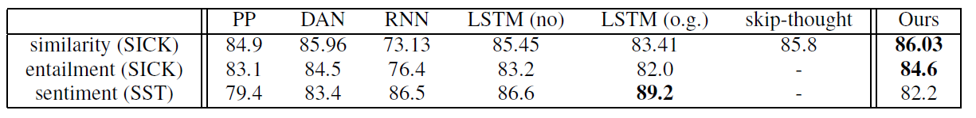
EXPERIMENTS
SUPERVISED TASKS
For sentiment tasks ：
(a) “antonym problem”
(b) words like “not”
Notes:
The advantage is not as significant as in the textual similarity tasks. This is possibly because similarity tasks rely directly upon cosine similarity, which favors our method’s approach of removing the common components (which can be viewed as a form of denoising), while in supervised tasks, with the cost of some label information, the classifier can pick out the useful components and ignore the common ones.
Finally, we speculate that our method doesn’t outperform RNN’s and LSTM’s for sentiment tasks because
(a) the word vectors —and more generally the distributional hypothesis of meaning —has known limitations for capturing sentiment due to the “antonym problem”,
(b) also in our weighted average scheme, words like “not” that may be important for sentiment analysis are downweighted a lot.
To address (a), there is existing work on learning better word embeddings for sentiment analysis (e.g., (Maas et al., 2011)). To address (b), it is possible to design weighting scheme (or learn weights) for this specific task.

Slide 16
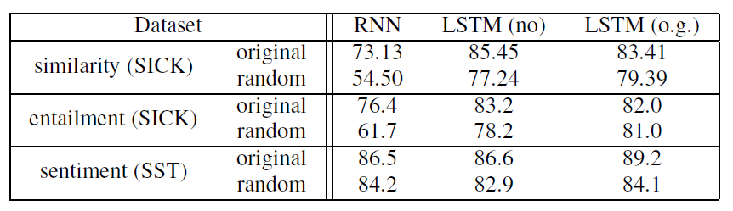
EXPERIMENTS
THE EFFECT OF THE ORDER OF WORDS IN SENTENCES
Notes:
word order does play some role，shuffle后RNN和LSTM都降
但本文方法好，则说明表达能力本身强
An interesting future direction is to explore if some ensemble idea can combine the advantages of both approaches. 如何结合两种的优点

Slide 17
THANKS
Ni Yihan

